Slide 1
Chapter 5: RTL Coding Guidelines
Reuse Methodology Manual for System-On-Chip Designs
Notes:
This is the light cover slide option.

Slide 2
5.5 Coding for synthesis
The following guidelines aim to achieve The following :
– Performance . –Simplification for static timing analysis. –Gate Level behavior that matches the original RTL – Testability

Slide 3
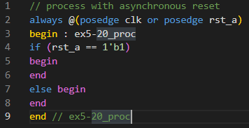
5.5 Coding for synthesis
5.5.1 Infer Registers
For Sequential Logic :
Guideline – Using flip-flops helps to achieve consistency of design . – For initializing The registered signal, -Use reset signal rather than using ‘Inital Statement’ As it causes mismatches between pre & post synthesis , It’s not synthesizible for ASIC flow , and sometimes Sometimes It’s synthesizible for FPGA flow tools (Ex. initializing memories)

Slide 4
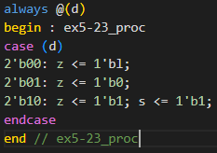
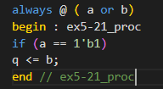
5.5 Coding for synthesis
5.5.2 Avoid Lathes
Rule – Avoid using any latches in your design [They are more susceptible to noise as they are level sensitive] Note – Use a design checking tool to check for latches in your design
All latches must be instantiated and you must provide documentation that
lists each latch and describes any special timing requirements that result from the
latch.
A latch is infered of missing else statement: | A latch is infered of assigments and conditions _case 2’b11_ .

Slide 5
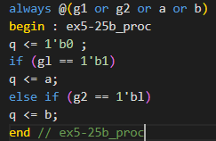
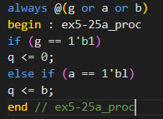
5.5 Coding for synthesis
5.5.2 Avoid Lathes
Avoiding Latches can be done as follows : 1)Assign default values at the beginning of combinational always_block . 2)Assign outputs for all input conditions . 3)Use else (instead of elsif) for the final priority branch .
Poor style of coding : Output is assigning output for all inputs coditions . | Recommended style : Output has a default value .

Slide 6
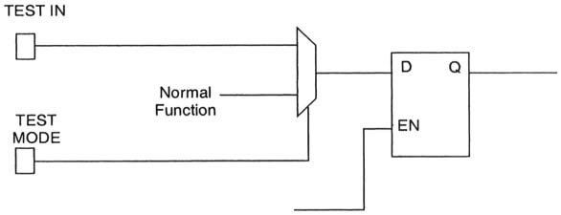
5.5 Coding for synthesis
5.5.3 If you must use Lathes
Rule – We can use latches for testability as follows since it’s not avoidable in this case . – This can be achieved by using a mux between the normal function and the test data to the mux. The selector can be an enable to test mode .

Slide 7
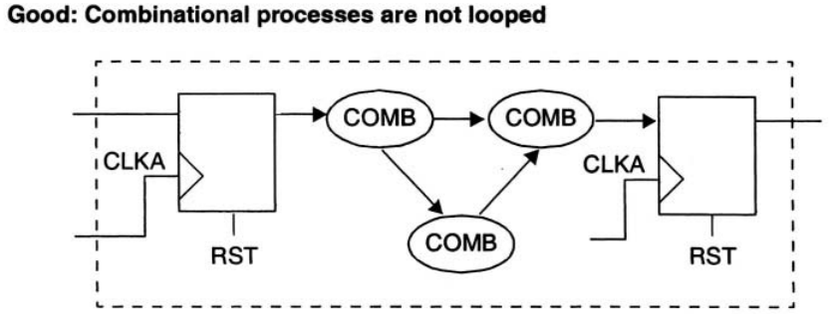
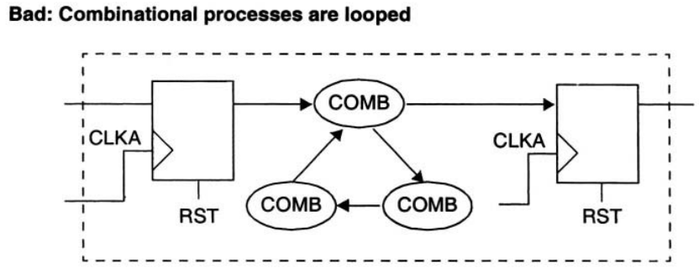
5.5 Coding for synthesis
5.5.4 Avoid Combinational Feedback
Guideline – Avoid using any Combinational looping in your design . As it makes STA very hard .
Instead of This combinational loop : | Break The loop into one forward direction with no feedback: v
Instead of This combinational loop : | Break The loop into one forward direction with no feedback: v

Slide 8
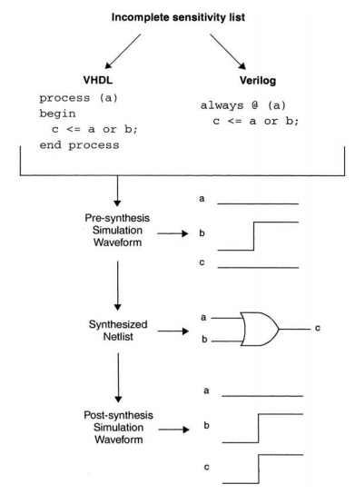
5.5 Coding for synthesis
5.5.5 Specify Complete Sensitivity Lists
Guideline – Rule – Include a complete sensitivity list in each always (Verilog) blocks To avoid mismatch between pre & post syntehsis .

Slide 9
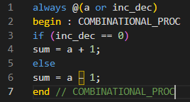
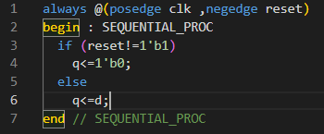
5.5 Coding for synthesis
5.5.5 Specify Complete Sensitivity Lists
Guideline – Only include the necessary signals in the sensitivity list ,As adding unnecessary signals to the sensitivity list slows down simulation , As the always can be unnecessarily retriggered many times .
Combinational block: Sensitivity list should : -Contain all read signals in the block That appears in the RHS or Conditions . -We can use always(*) to contain all read signals in the always block . | Sequential Block : Sensitivity list should : -Contain edge triggerd clock . -Incase of asynchrounous reset , Edge triggered reset must be included .

Slide 10
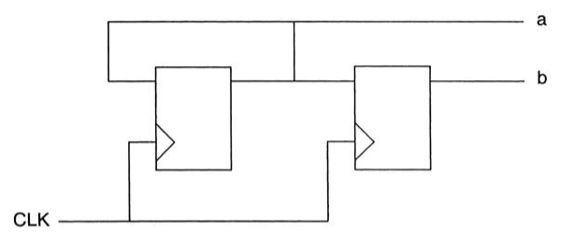
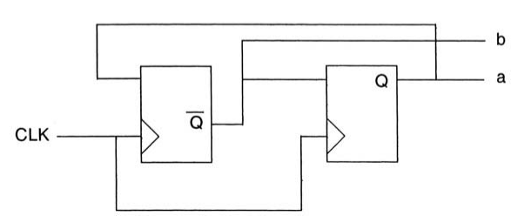
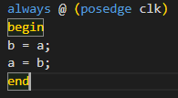
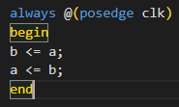
5.5 Coding for synthesis
5.5.6 Blocking and Nonblocking Assignments
Rule – When writing synthesizable code, always use nonblocking
assignments in always@ (posedge clk) blocks.
Blocking assignment : Execution is done sequentially (line by line ). So in the following example , - a is assigned to b . - a is assigned to b which already has the value of a . so a just loops around and is reassigned every clock. | Non_blocking assignment: Execution is done concurrently (RH sides are evaluated then assigned to LH sides each clock ) and that’s the intended behaviour .

Slide 11
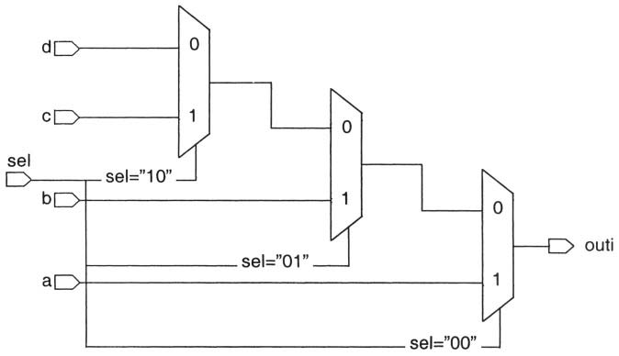
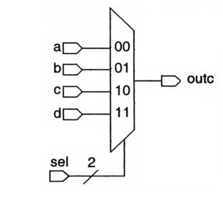
5.5 Coding for synthesis
5.5.8 Case Statements vs. if-then-else Statements: Guideline – The multiplexer is a faster circuit. So, if the priority-encoding structure is not required, case statement is prefered over if-else statement . - Note _ An if-then-else statement can be useful if you have a late-arriving signal like the shown example , if ‘a’ is a late arriving signal , it can be connected to the fastest path (first if condition )
Case Statement : | If -else statements : v

Slide 12
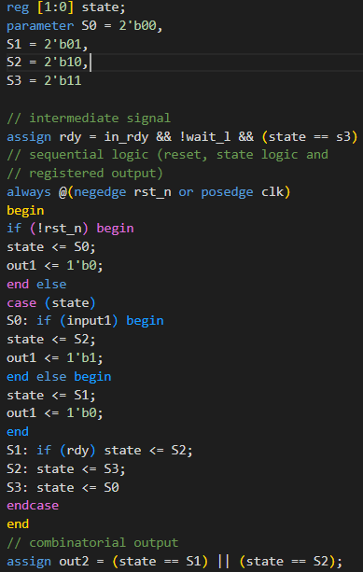
5.5 Coding for synthesis
5.5.9 Coding Sequential Logic: Guideline _ Code sequential logic, including state machines, with one sequential
sequential process. Improve readability by generating complex intermediate variables
outside of the sequential process with assign statements. Guideline – Keep FSM and non-FSM logic in separate modules if they have different synthesis requirements. For example, a very complex FSM might need to be in a separate module from a complex arithmetic block.

Slide 13
5.5 Coding for synthesis
5.5.10 Coding Sequential Logic: Guideline _ Guideline – Keep late-arriving signals with critical timing closest to the output of a
logic block. For example, use the late-arriving signal early in an if-else block (first if condition in if-else statements) ----------------------------------------------------------------------------------- 5.5.11 Avoid Delay Times: Guideline – Do not use any delay constants in RTL code for the following reasons : 1) Delays aren’t synthesizable . 2) They may may cause simulation behavior to differ from synthesis results. Instead , 1) Use Non_blocking assignments in your sequential designs 2)Adjust clock timing to your RTL and the interface timing from and to your code. ----------------------------------------------------------------------------------- 5.5.12 Avoid full_case and parallel_case Pragmas : Guideline (Verilog only) –Write Verilog case statements to cover all cases with no overlap. Do not use the full_case or parallel_case pragmas, because these cause a difference in code interpretation between synthesis and simulation. "full_case" removes latches from the design.
• "parallel_case" removes large, slow priority encoders from my designs.

Slide 14
5.6 Partitioning for Synthesis
– The aim for good partitioning of the design is the following : -Better synthesis results
-Faster compile runtimes
-Ability to use simpler synthesis strategies to meet timing

Slide 15
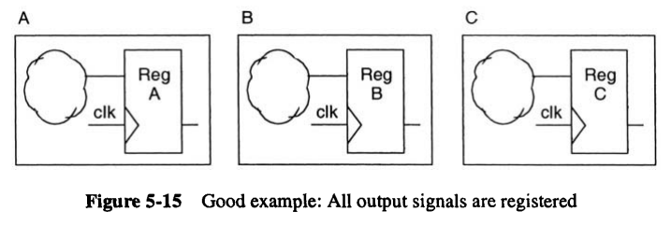
5.6 Partitioning for Synthesis
5.6.1 Register All Outputs
Guideline – For each subblock of a hierarchical macro design, register all output
signals from the subblock for the following benefits : As This Simplifies the synthesis process: 1) It makes output drive strengths and input delays predictable. [Reg2out path type] 2) All the inputs of each block arrive with the same relative delay.

Slide 16
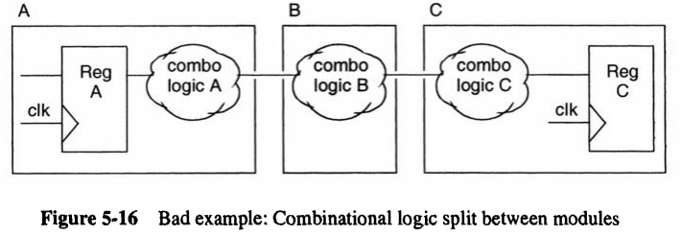
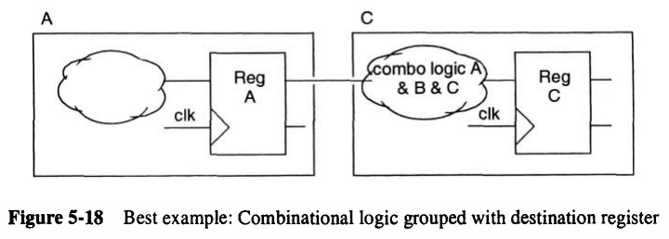
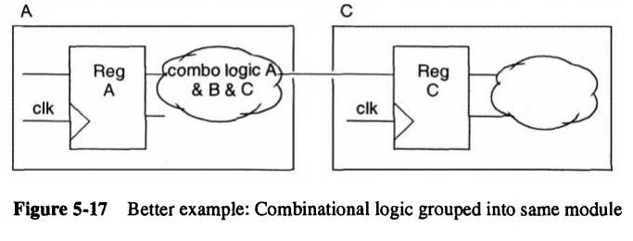
5.6 Partitioning for Synthesis
5.6.2 Locate Related Combinational Logic in a Single Module
Guideline – Keep related combinational logic together in the same module. Because : 1)The synthesis tools have flexibility to optimize logic within The module itself yet can’t optimize beyond this as it maintains hierarchical boundaries in the design between different modules . 2)This eases time budgeting between blocks and allows for faster simulation.
Guideline – It’s best to group all related logic to the destination block . This helps to in timing optimization .

Slide 17
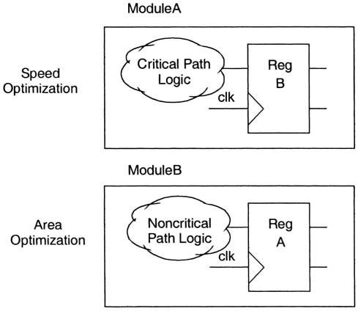
5.6 Partitioning for Synthesis
5.6.3 Separate Modules That Have Different Design Goals
As shown the following example: It shows a design where the critical path logic is grouped into a separate module from the noncritical path logic . _ This differntiates the behaviour of the synthesis tool for both modules optimization : Module A: Speed optimization is needed . Module B: Area optimization is needed .

Slide 18
5.6 Partitioning for Synthesis
5.6.4 Asynchronous Logic Guideline – Avoid asynchronous logic for the following reasons :
1)Asynchronous logic is more difficult to design correctly and verify. 2)Correct timing and functionality may be technology dependent, which limits the portability of the design.
Guideline – If asynchronous logic is required in the design, partition the asynchronous logic in a separate module from the synchronous logic:
1) Isolating the asynchronous logic in a separate module makes code inspection much
easier. 2)Asynchronous logic needs to be reviewed carefully to verify its functionality
and timing.

Slide 19
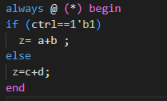
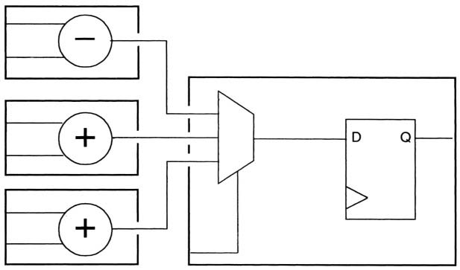
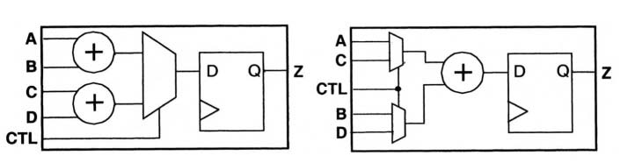
5.6 Partitioning for Synthesis
5.6.5 Arithmetic Operators: Merging Resources
As we see in this example :That normally two adder are to be created , Yet The synthesis tool will more likely to synthesize one adder to be shared in two additions which is called (Merging Resources)
Poor way of partitioning the operators that can be shared by hierarchically seperating them into differernt modules. | Recommended way of partitioning the operators that can be shared by combining them into the same hierarchy .

Slide 20
5.6 Partitioning for Synthesis
5.6.6 Partitioning for Synthesis Runtime Guideline – The most important considerations in partitioning should be the logic function, design goals, and timing and area requirements to optimize the runtime of synthesis process this can be done as follows : 1)Grouping related functions together is much better than splitting functions artificially. 2)Good timing budgets and appropriate constraints can have a larger impact on
synthesis runtime than circuit size does. 3) Grouping logic according to design goals [Area _Timing or both ], the synthesis strategy can be focused, reducing synthesis runtime.

Slide 21
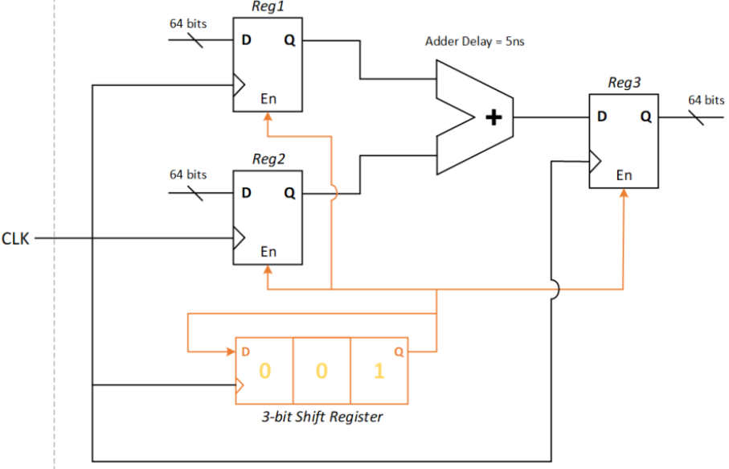
5.6 Partitioning for Synthesis
5.6.7 Avoid Timing Exceptions Timing Exceptions : Those are the pathes that doesn’t require the data to be transfered withing one clock . -False paths : Timing path’s not required to meet its timing constraints for the design to function properly . for the STA tools they maybe identified as failling paths yet the designer knows they aren’t failling .
-Multicylce paths : Design tools including synthesis, static timing analysis, and place and route tools must allow the data to take more than one clock cycle to traverse the path
Guideline – Avoid multicycle paths and other timing exceptions in your design.

Slide 22
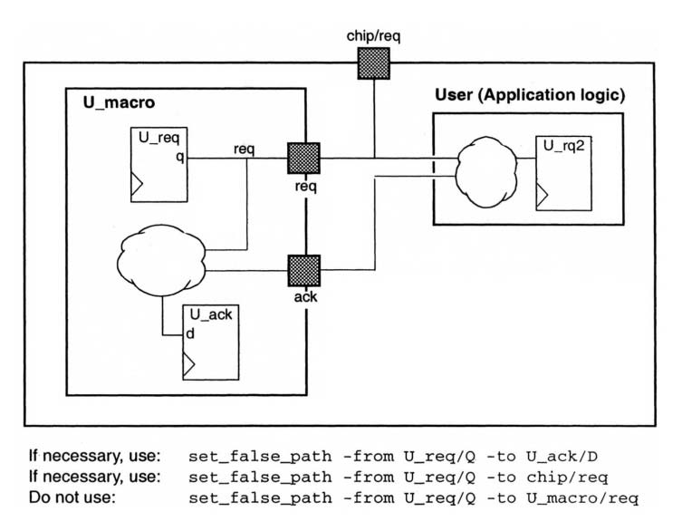
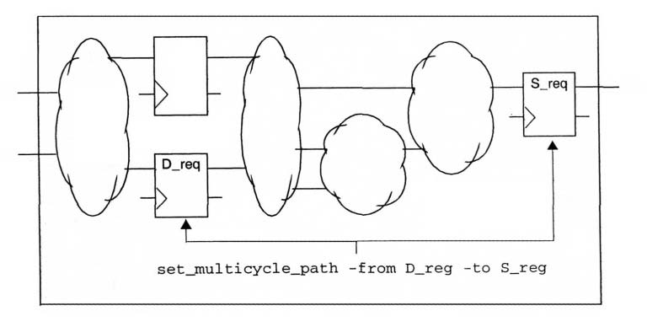
5.6 Partitioning for Synthesis
5.6.7 Avoid Timing Exceptions Guideline – If you must use timing exceptions in your design, use start and end points which are guaranteed to exist and be valid at the chip level.
False Paths | MultiCycle paths
Guideline – Avoid false paths in your design. As the designer may accidentally ignore a valid warning of a time failling path . | Use Isolating point-to-point exceptions as shown in the following example . A multicylce path is defined between D_reg to S_reg This improves synthesis and timing results .

Slide 23
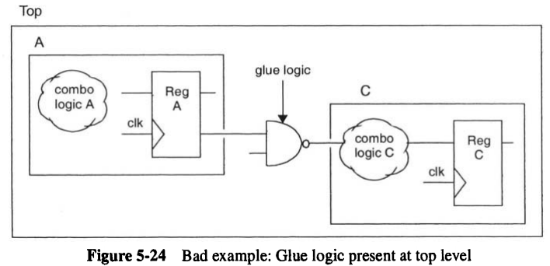
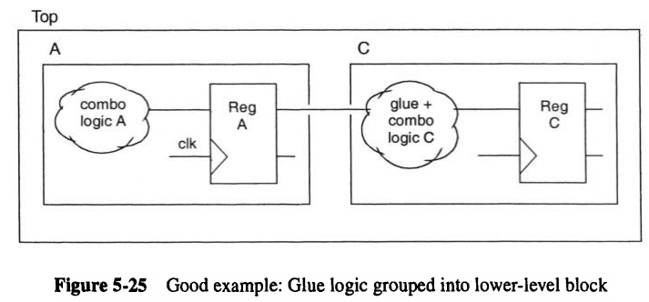
5.6 Partitioning for Synthesis
5.6.8 Eliminate Glue Logic at the Top Level
Guideline – Do not instantiate gate-level logic at the top level of the macro hierarchy.
We can in the following example that : Optimization is limited because synthesis
tools cannot merge the NAND with the combinational logic inside Block C.
This eleminates any extra effort to compile any glue logic at the top level .

Slide 24
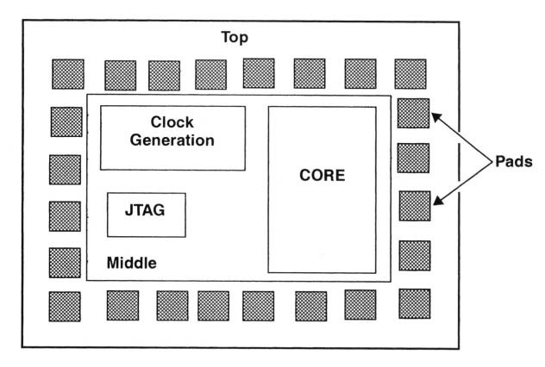
5.6 Partitioning for Synthesis
5.6.9 Chip-Level Partitioning **********
Guideline – Make sure that the top level of the design contains only : 1)the I/O pad ring 2)clock generator. - The next level of hierarchy contains IEEE 1149.1 boundary scan (JTAG) modules and the core logic. The clock generation circuitry is isolated from the rest of the design as it is normally hand crafted and carefully simulated.

Slide 25
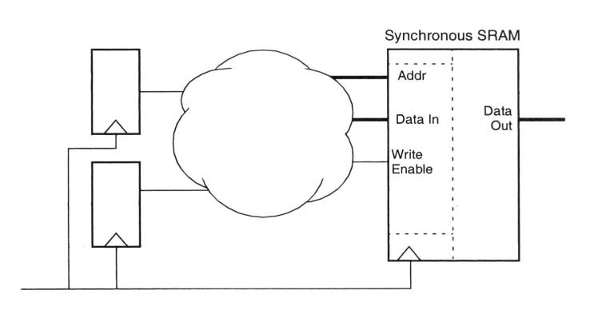
5.7 Designing with Memories
Guideline – Keep memory interface pins at the top level of a macro cell to allow user choice of memory implementation, interface, and test.
Note _ Synchronous Rams are the only reliable memories for SoC because asynchronous memories have problems generating write enable pulses since it’s not associated with the system clock . Plus Synchrounous Rams are faster than asynchrounous ones . yet they need more complex interfaces.

Slide 26
5.8 Code Profiling
Guideline – code profiling can assist you in optimizing your code for simulation speed .
Note _Tracking how often each line of code is executed during a given simulation run can reveal bottleneck areas in the model .

